Slide 1

Climate Change:
Why We Must Act
Presentation prepared by
Earth Day: Climate Action
© Creative Commons Attribution 4.0 International

Slide 2
The Science Has Been
Settled for 150 Years
Basic chemistry and physics going back to 1861
  Sunlight as visible light first passes through the atmosphere unhindered (CO2 doesn’t interact with visible light)
  The sunlight heats the earth, and is then re-radiated as infrared radiation at a wavelength that CO2 does like to absorb
  The energy absorbed by the CO2 heats the atmosphere
  In Science-Speak: “This [re-radiated infrared] radiation is most intense at wavelengths very close to the principal absorption band (13 to 17 microns) of the carbon dioxide spectrum.” – 1959 Scientific American article explaining global warming
  No one in the scientific community disputes this basic mechanism. Even climatologists who are skeptical of the urgency of climate change accept the role of CO2 as a greenhouse gas warming the atmosphere.
Notes:
John Tyndall’s 1861 publication on the role of greenhouse gases in maintaining the Earth’s temperature:
http://www.siliconrepublic.com/clean-tech/item/23757-irish-scientist-john-tyndal
American Institute of Physics on Tyndall: http://www.aip.org/history/climate/co2.htm
Scientific American 1959 article (clear explanation): http://www.scientificamerican.com/article/carbon-dioxide-and-climate/

Slide 3
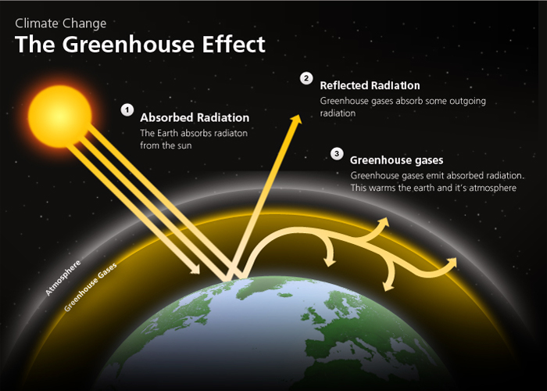
Why the Earth Is Not Like the Moon
Notes:
Credit: http://www.edfenergy.com/energyfuture/energy-gap-climate-change/greenhouse-effect
“The Earth's atmosphere is like a greenhouse. It lets light both in and out, but keeps heat trapped inside. This is called the Greenhouse Effect.
The Earth’s surface absorbs light energy from the sun and emits it as heat energy. Greenhouse gases like carbon dioxide absorb this heat and emit some of it back at the Earth.
Humanity needs the Greenhouse Effect. Without it the Earth would be too cold to live on. But the more greenhouse gas released, the stronger the effect becomes, and the more the Earth warms up.”

Slide 4
A Small Amount of CO2
Traps a Lot of Heat
CO2 is only 0.037% of the atmosphere, yet makes life on Earth possible.
The fact that CO2 is so powerful means that you don’t have to add much back in to have an effect.
We have increased the amount of CO2 in the atmosphere by a whopping 40% since the start of the Industrial Revolution.

Slide 5
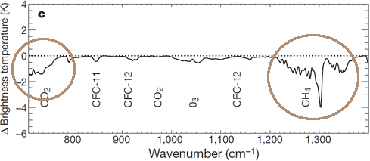
Satellites Can Detect the Increase in the Greenhouse Effect
Satellite data show less infrared radiation (heat) is escaping into space
This is happening in the wavelengths for CO2 and methane
In other words, we can see the greenhouse effect strengthen in real time

Slide 6
How Much Extra Heat Is Trapped?
Rate at which we are accumulating extra heat:
  0.6 Watts per square meter (W/m²) extra energy. That may not sound like much, but…
  Over the entire surface of the Earth, that equals 250 TRILLION Joules per second (1 Watt = 1 Joule/second of energy)
  That equals the energy of 400,000 Hiroshima bombs PER DAY, 365 days a year
    90% of that goes into the ocean
Notes:
http://thinkprogress.org/climate/2013/12/22/3089711/global-warming-hiroshima-bombs

Slide 7
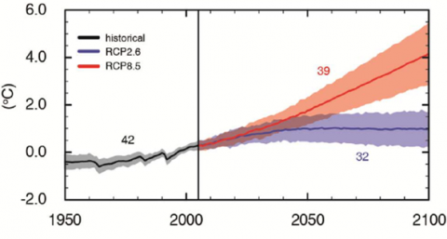
Most Likely Scenario: 4° By 2100
The latest UN IPCC report changed the way they describe warming scenarios, leading some people to think they have lowered predictions.
But the most likely scenario still predicts 4° or more warming by 2100.
Notes:
http://www.realclimate.org/index.php/archives/2013/09/the-new-ipcc-climate-report
IPCC = Intergovernmental Panel on Climate Change http://www.ipcc.ch

Slide 8
Current UN IPCC Predictions
“The future warming by 2100 – with comparable emission scenarios – is about the same as in the previous report. For the highest scenario, the best-estimate warming by 2100 is still 4 °C.” –realclimate.org
  Figure 2 The future temperature development in the highest emissions scenario (red) and in a scenario with successful climate mitigation (blue) – the “4-degree world” and the “2-degree world.”
“What is new is that IPCC has also studied climate mitigation scenarios. The blue RCP2.6 is such a scenario with strong emissions reduction. With this scenario global warming can be stopped below 2 ° C.” –realclimate.org
Notes:
http://www.realclimate.org/index.php/archives/2013/09/the-new-ipcc-climate-report/
RealClimate is a commentary site on climate science by working climate scientists for the interested public and journalists: http://www.realclimate.org/index.php/archives/2004/12/about/

Slide 9
Only 4° Warming? Big Deal!
When talking about a 4° warming, we’re not talking about local temperatures.
Today it’s 84°, tomorrow it might be 65° – that’s not what we’re talking about.
We’re talking about the Global Average Temperature.
This is the average over the entire earth, including the oceans, land, and the atmosphere.

Slide 10
Global Average Temperature
Global average temperature is extremely stable
It is determined by output from the sun
Has stayed within a 1° – 2°C range for 12,000 years, since humans began farming
The last Ice Age was only 3° - 5°C cooler than present
Business as usual estimate predicts an increase of 4°C by 2100
Notes:
http://earthobservatory.nasa.gov/Features/WorldOfChange/decadaltemp.php
“A one-degree global change is significant because it takes a vast amount of heat to warm all the oceans, atmosphere, and land by that much. In the past, a one- to two-degree drop was all it took to plunge the Earth into the Little Ice Age. A five-degree drop was enough to bury a large part of North America under a towering mass of ice 20,000 years ago.”

Slide 11
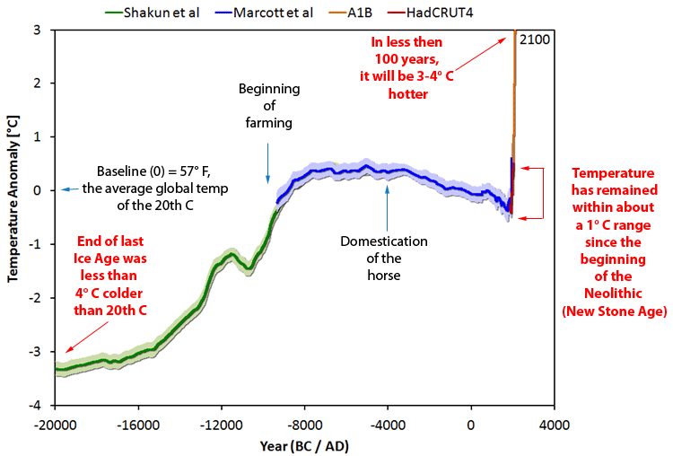
The Wheelchair Curve
Notes:
The original graph combining different temperature reconstructions, observations, and predictions was assembled by Jos Hagelaars:
http://ourchangingclimate.wordpress.com/2013/03/19/the-two-epochs-of-marcott/.
Annotations here by Erica Ackerman

Slide 12
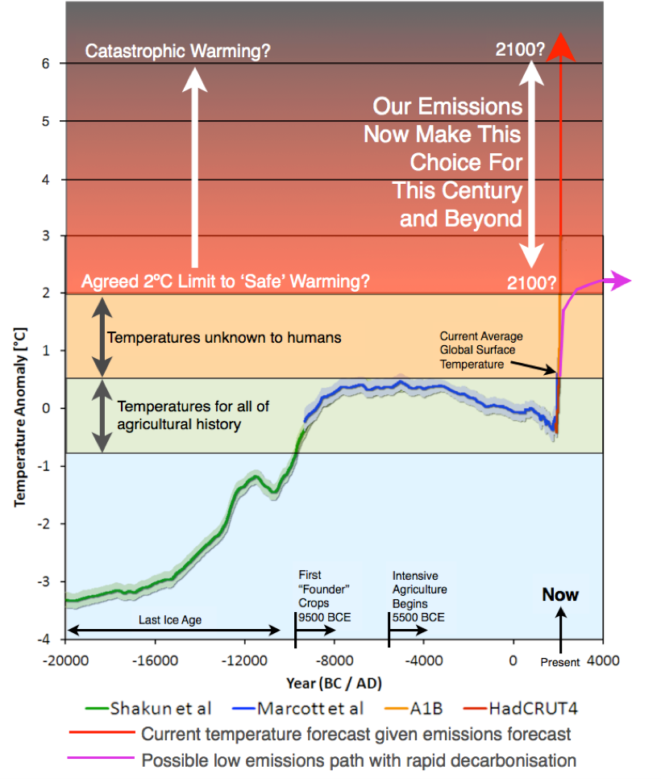
The Wheelchair Graph
World Bank Version
Notes:
http://blogs.worldbank.org/futuredevelopment/climate-change-myth

Slide 13
Skeptic Positions
Skeptic positions boil down to:
  It’s not happening
  It’s not caused by humans
  There’s nothing we can do about it anyway

Slide 14
It’s Not Happening?
13 of the hottest years since recordkeeping began have occurred in the last 15 years
NASA visualization of temperature change since the 1880s:
http://earthobservatory.nasa.gov/Features/WorldOfChange/decadaltemp.php
Notes:
http://www.politifact.com/truth-o-meter/statements/2013/feb/15/barack-obama/barack-obama-says-12-hottest-years-record-have-com/

Slide 15
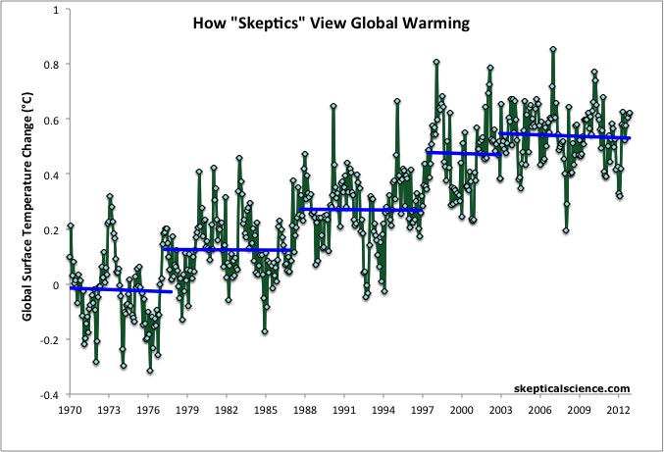
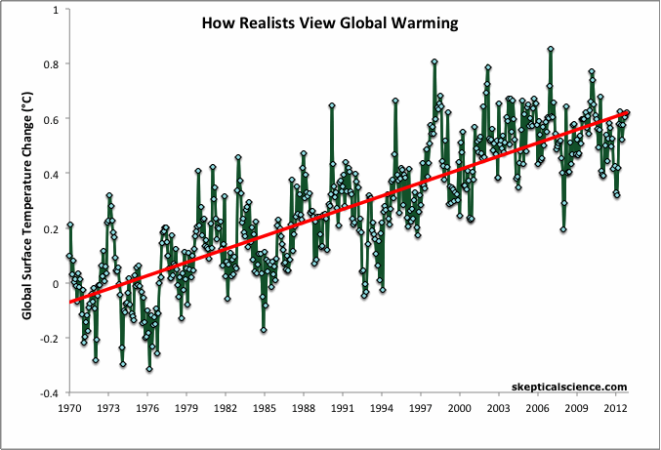
Has There Been a “Pause” in Warming? Down the Up Escalator.
Natural variability (like the preponderance of La Niña over El Niño years) still causes fluctuations in surface temperature.
The overall trend is still up. A lot.
This is called “going down the up escalator”.
Notes:
Image credit: http://www.skepticalscience.com/graphics.php?g=47
In the last decade the temperature has risen one tenth of a degree, as opposed to the two tenths of a degree in the preceding decade. So it is still going up, just not as fast.

Slide 16
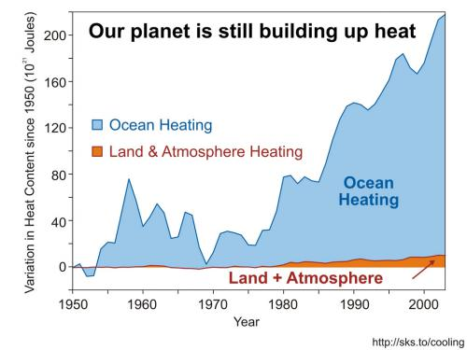
More on the “Pause”
90% of warming goes into the oceans, not surface temperature.
Warming-caused changes in the Trade Winds have pushed more of that heat into the deeper ocean.
La Niña years have predominated
Notes:
Image credit: http://www.skepticalscience.com/graphics.php?g=4
Trade winds study: http://www.theguardian.com/environment/climate-consensus-97-per-cent/2014/feb/10/unprecedented-trade-winds-global-warming-oceans
How Trade Winds push warmth down: http://www.realclimate.org/index.php/archives/2013/09/what-ocean-heating-reveals-about-global-warming/
La Nina predominance since 2000: https://skepticalscience.com/graphics.php?g=67

Slide 17
There’s Nothing We Can Do?
This attitude reflects “a fundamental lack of faith in American business and American ingenuity”
- President Obama
A certain amount of warming is already inevitable
It is in our hands to control how much:
2° C ?
3° C ?
4° C ?
5° C ?

